Slide 1
Weil-McLain’s Warranty Website
https://weil-mclain.etq.com/prod/reliance
The website is used by distributors to process approved claims
IF YOU NEED TO START A NEW CLAIM CALL 800-654-2109 opt. 3

Slide 2
Things to note
You will need a user name and log in to access the site.
If a claim has been assigned to you it has already been approved. Non-approved claims don’t make it to this step.
If a claim gets sent back to you check the comment section near the top of the document. The folks reviewing the claim may want you to correct or add something.

Slide 3
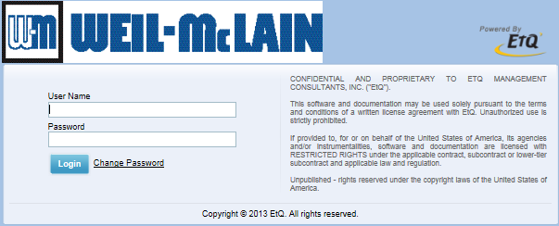
Ways to get to the website
Clicking the notification link sent to your email will bring you straight to that claim.
Or you can log into the website’s home page https://weil-mclain.etq.com/prod/reliance

Slide 4
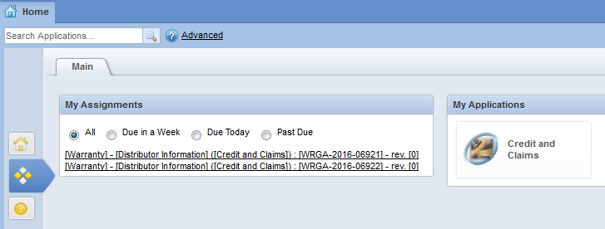
Once logged in, you will see all the claims assigned to you. If there are none there, then you have none assigned.
There are 2 clams currently assigned to you. Click them to open the claim forms.

Slide 5
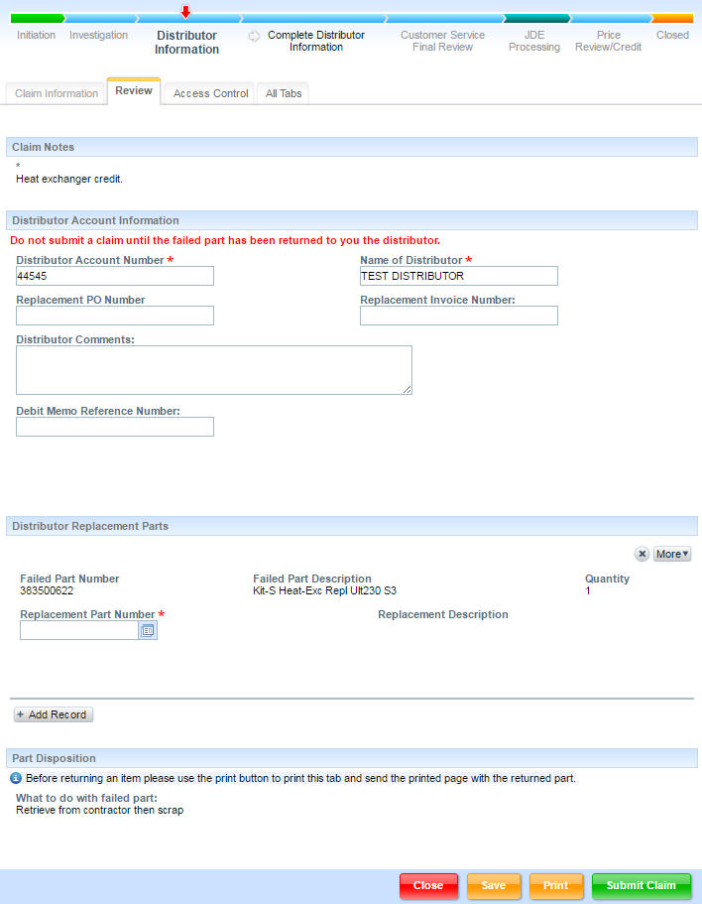
NAVIGATING THE FORM
Retrieve failed part from contractor before completing the claim.
Take a look at the notes
Fill out info
Enter replacement part: Contact your customer service rep if you don’t know what the proper part # should be.
Save
Print (optional): this will open an electronic copy which you can save or print if you like.
Note what to do with the failed part.
Click “Submit Claim”
The red arrow (circled) will move over the next phase. Close the claim, you’re done!
1
2
3
7
4
5
6

Slide 6
Getting Credit
Properly Completed claims will be credited within 3-5 business days.
You will be sent an emailed notification and a mailed credit memo upon closure of the claim.

